Slide 1
hands on training-4(1)
File created on: 12/10/2024 1:27:22 PM

Slide 2
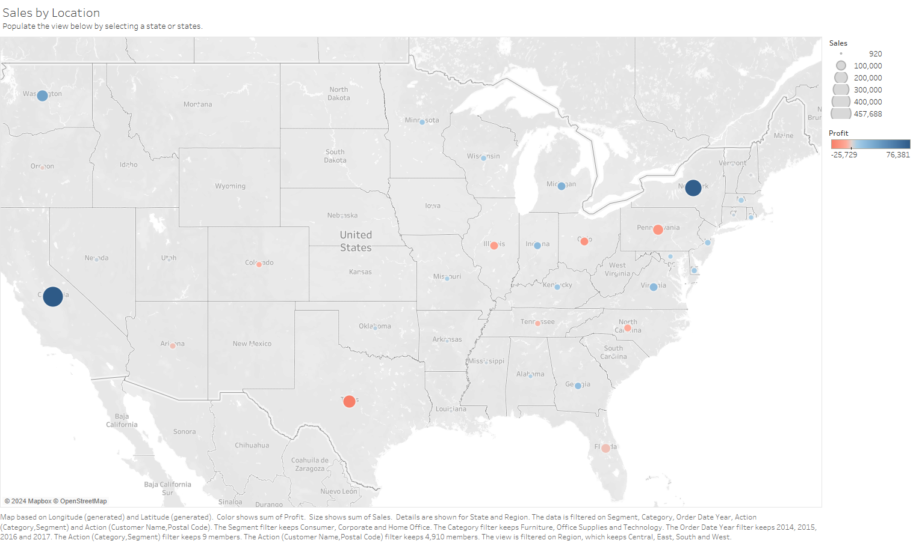

Slide 3
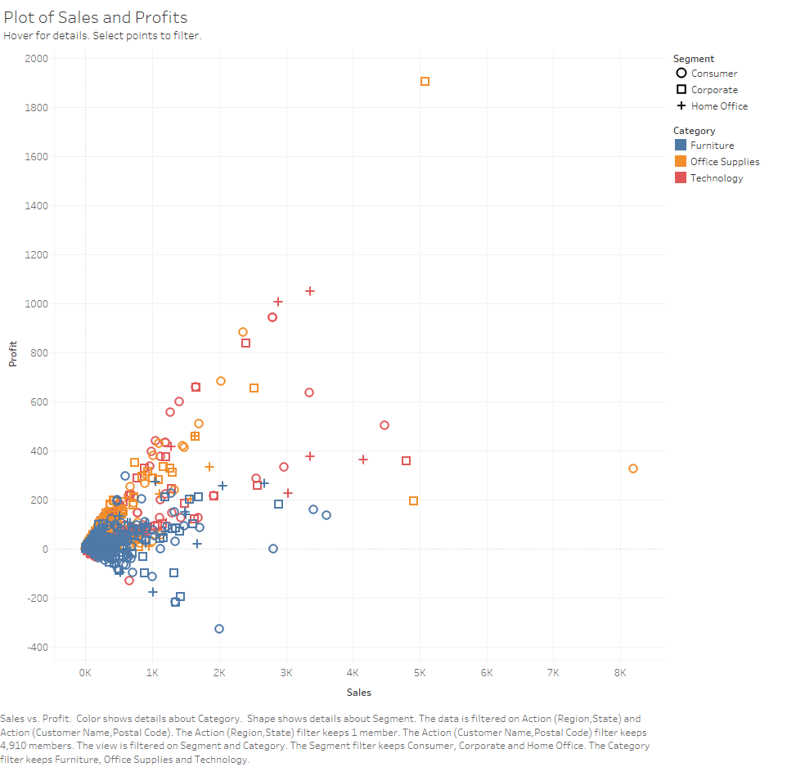

Slide 5
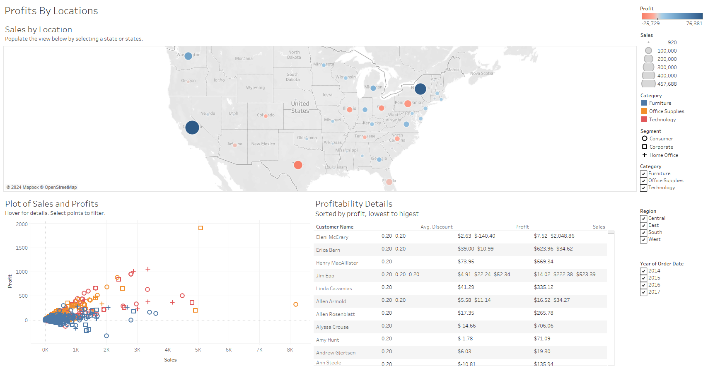

Slide 6
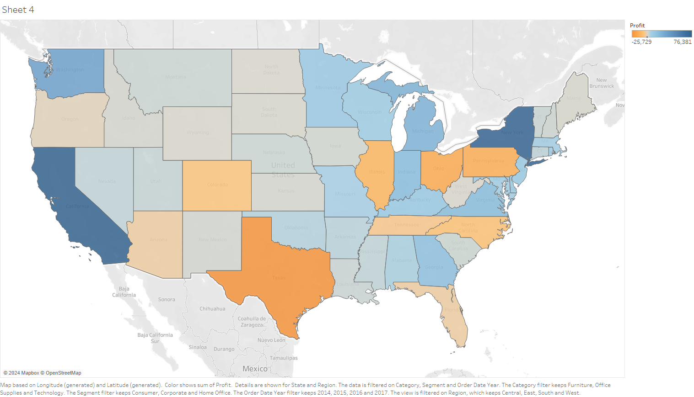

Slide 7
